Slide 1
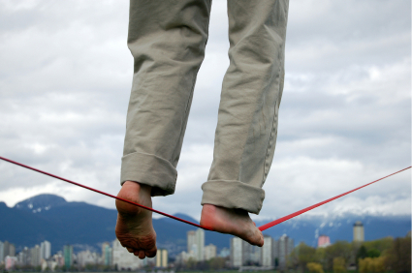
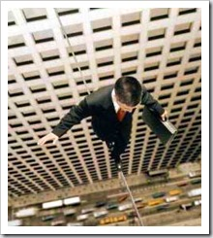
Balanced & Unbalanced Forces

Slide 2

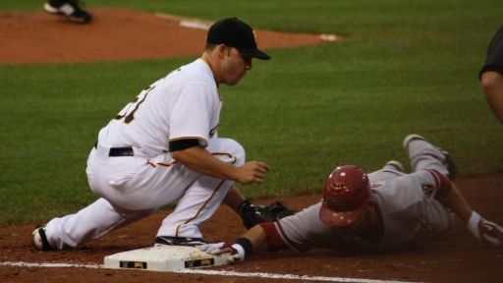
Forces Instant Replay

Slide 3
Newton’s Law of Motion says:
“In order to move an object with mass,
you need to apply a force”
The greater the mass = The greater inertia => more force is needed

Slide 4

Force
What is force?
  Push or Pull
    It’s what causes “things” to accelerate
1000 kg

Slide 5
Balanced v. Unbalanced Forces
If all forces are balanced there is no acceleration in any direction.
  (Either Zero Motion or Constant Velocity)
If one force is greater than the opposing force we get acceleration in a direction.

Slide 6

Balanced Forces
(Balanced Forces = No Acceleration)
Object
5 N
5 N
Notice that all the forces are equally pointed in the opposite direction. Hence they balance each other – or cancel each other.
Equal Pushing
Forces may cancel each other and produce No Acceleration!

Slide 7
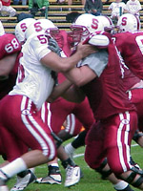
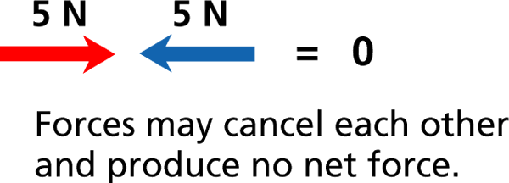

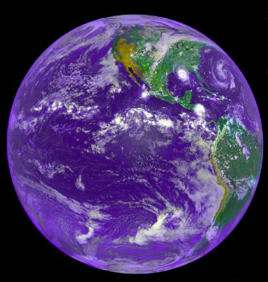
Balanced Forces
(Balanced Forces = No Acceleration)
Ground pushes up
Gravity pulls down
Gravity pulls down on you…
The ground pushes back up…
THIS KEEPS YOU WHERE YOU ARE!
If these football players push
on each other equally as hard,
will either one move?

Slide 8
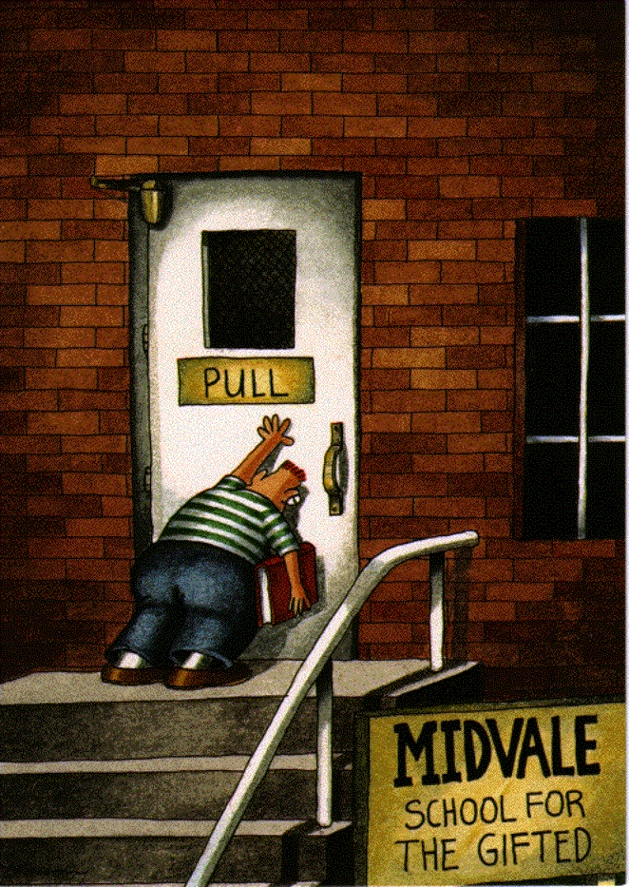
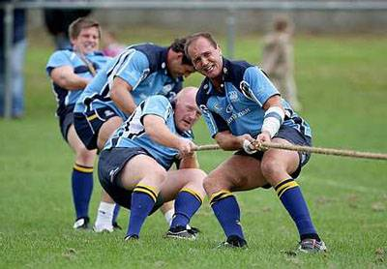
Balanced Forces
(Balanced Forces = No Acceleration)
5 N
5 N
Equal Pushing
Equal Pulling
5 N
5 N
Forces may cancel each other and produce No Acceleration!

Slide 9
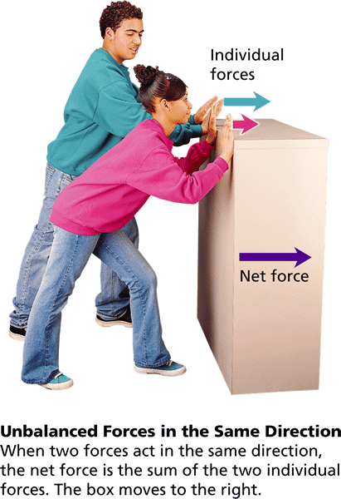
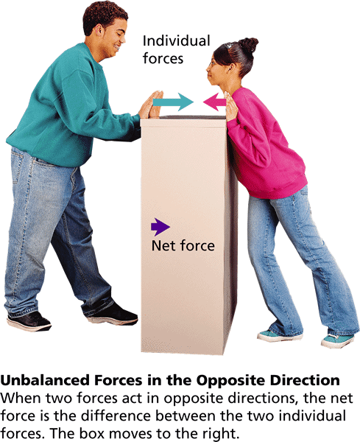
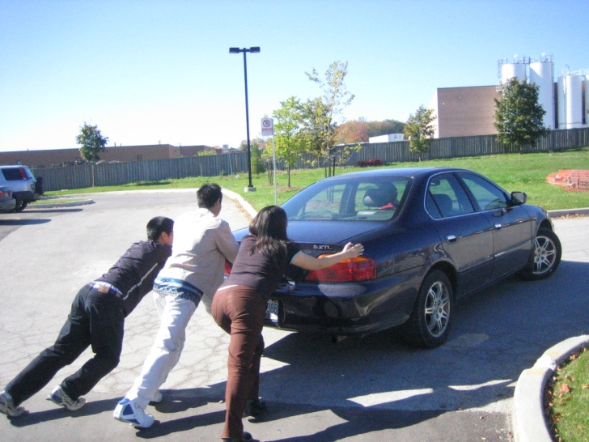
Unbalanced Forces
Causes Acceleration
Adding Forces
Subtracting Forces

Slide 10
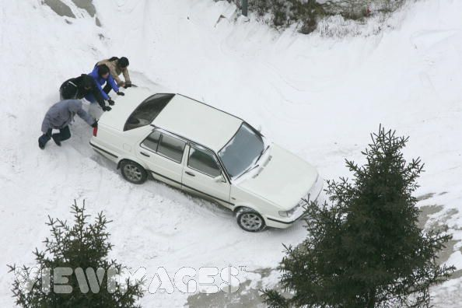
Adding Forces
5 N
5 N
= 10 N
Two forces can add together to produce a larger net force than either original force.
  Positive Acceleration occurs (Speed up)

Slide 11
Unbalanced Forces
Causes Acceleration
Adding Forces
Object
5 N
5 N
Notice that all the forces are pointed in the same direction. Hence they add together.

Slide 12
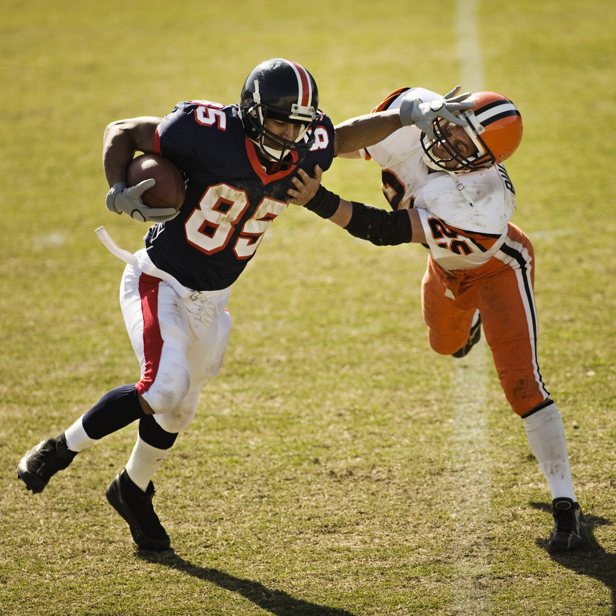
Subtracting Forces
10 N
= 5 N
5 N
Two forces can subtract to produce a net force in the direction of the larger force.
  Negative Acceleration occurs (Slow Down)

Slide 13
Unbalanced Forces
Causes Acceleration
Subtracting Forces
Object
5 N
5 N
5 N
Notice that all the forces are unequal and pointed in the opposite direction. Hence they are unbalanced and in opposition to each other – or one partially cancels the other.

Slide 14
Balanced Forces
 | Balanced Push i.e. Pushing a Car | No Acceleration
 | Balanced Pull i.e. Tug-o-war | No Acceleration
10N
10N
10N
10N

Slide 15
Un-Balanced Forces
Additive | Un-Balanced Same Direction | Faster Acceleration
Subtractive | Un-Balanced Opposite Direction | Slower Acceleration
10N
10N
10N
10N
10N

Slide 16
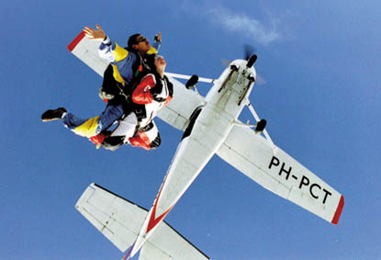
Balance between
Gravity and Friction
Q: If the friction of the air and the pull of gravity were in perfect balance, what
would the skydiver be doing?
A: The skydiver would be going a constant velocity (moving with no acceleration) down towards the ground until it hit the ground.
The skydiver is colliding with the
molecules of gas in the air!
Which slows down the fall of the skydiver!

Slide 17

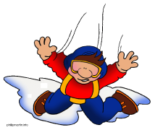
How it works
Constant Velocity
Notice that as the skydiver leaves the plane, the force of gravity accelerates him faster towards the earth; however, the moment he jumps out of the plane, another force begins to oppose gravity – Air Resistance, (Friction).
This friction with the air begins to slow down his rate of acceleration. Meaning, he’s still speeding up, just not as fast.
Once the force of air friction equals the force of gravity, the skydiver steadily descends towards earth at a constant velocity.
Accelerating
Accelerating
Air Resistance
30 m/s
0 m/s
Speed:
28 m/s
25 m/s
20 m/s
10 m/s
0 m/s
Constant Velocity
Gravity

Slide 18
Balanced Forces
(Balanced Forces = No Acceleration)
Wait a minute. This object was moving.
That’s Right. As you may have noticed, although I may have balanced forces, I might still be moving.
Notice that when the forces are balanced, the object might still be moving, but the objects are not accelerating, instead they have a constant velocity. Hence, once in motion – it’s always in motion unless acted upon by what? Another Force.
Object
5 N
5 N
Notice that all the forces are equally pointed in the opposite direction. Hence they balance each other – or cancel each other.
Equal Pushing
Equal Pulling
Forces may cancel each other and produce No Acceleration!

Slide 19

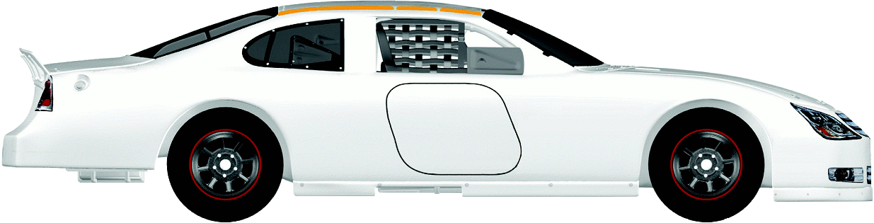
Constant Velocity
Distance [m]
0 1 2 3 4 5 6
1
2
3
4
5
Time [Sec]
In other words, you still need to use the gas peddle to balance out all the force of friction to keep you going at a constant speed.
5 N
5 N

Slide 20
Acceleration
1
2
To get an object to move faster, create an unbalanced force!
10 N
5 N

Slide 21
Balanced v. Unbalanced
Where would I place this to balance out the lever?
Video: Bill Nye_Balance [1:51min]
To keep the lever balanced - D x M = D x M

Slide 22
Balloon Lab
Velocity
Acceleration
Normal
Gravity

Slide 23
Balloon Lab
Velocity
Acceleration
Normal
Force (Friction)
Force (Thrust)
Gravity

Slide 24
Balloon Lab
Velocity
Acceleration
Normal
Force (Friction)
Gravity

Slide 25

Inertia: Resistance to the push / pull (force)
    Newton’s 1st Law of Motion:
      once in motion an object stays in motion - unless acted upon by another unbalanced force.
      An object at rest stays at rest – unless acted upon by another unbalanced force.
      (7 Inertia Demos)

Slide 26
Second Law of Motion:
Acceleration depends on the object’s mass and the net force acting on the object.
To move a mass, you need to apply a force
  More Force = more Acceleration
  More Mass = less Acceleration

Slide 27
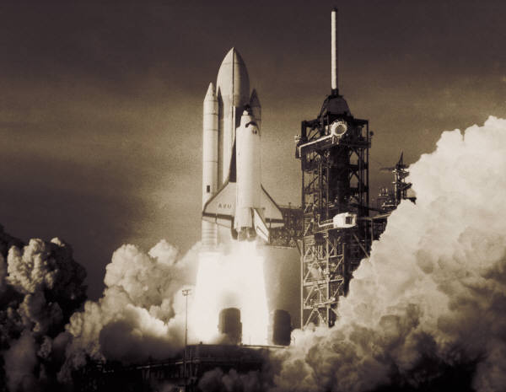

Third Law of Motion
“For every action there is an equal and opposite reaction.”
Rockets take off because of a force downwards from the bottom makes them accelerate in the opposite direction!
Ex: Skateboard Demo/ Wall
Upwards
motion
Downwards
force

